Slide 1
Background*
A multiple sequence alignment (MSA) is a sequence alignment of three or more biological sequences, generally protein, DNA, or RNA.
Features:
The set of query sequences are assumed to have an evolutionary relationship
Both conserved, mutated or re-arranged sequence fragments are observed
https://en.wikipedia.org/wiki/Multiple_sequence_alignment

Slide 2
Problems*
How to materialize/quantify the criteria/pattern in biology to some available basis for judging?
How to optimize the multiple decision making process to produce a result as good as possible?
How to save resources, such as time and memories, while computing the approach?
https://en.wikipedia.org/wiki/Multiple_sequence_alignment

Slide 3
Abstract*
Different types of approaches were developed in these conditions, including
Exact alignment methods based on dynamic programming
Progressive alignment methods based on phylogenetic distances of sequences
Iterative alignment methods based on state transition
Batzoglou S. The many faces of sequence alignment. Briefings in Bioinformatics, 2005,6(1):6−22

Slide 4
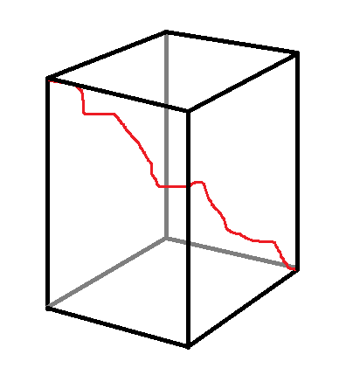
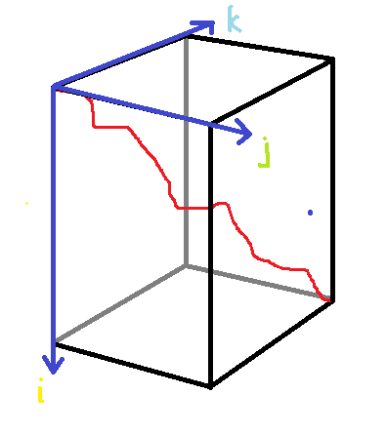
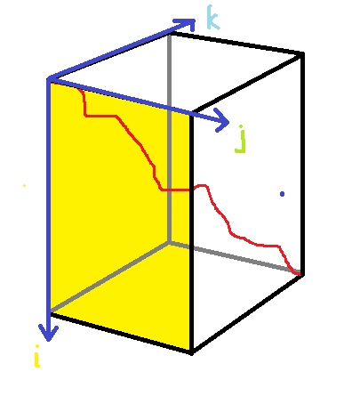
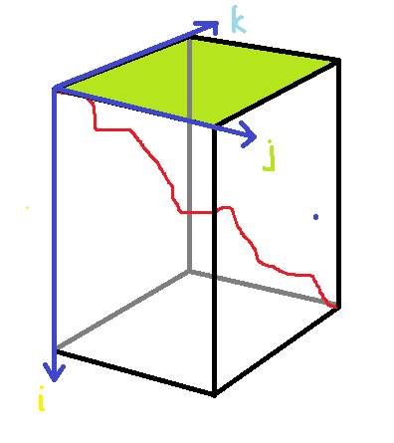
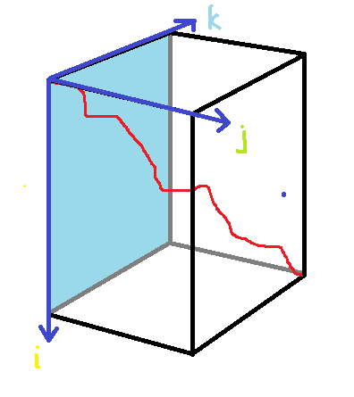
Approach 1: Exact alignment methods*
Basic idea:
generate a nth dimensional scoring matrix and represent the alignment result as a path inside it
score the matrix trace back all the possible path-building decisions to align a sequence
Example: smith-waterman algorithm
(from wikipedia)

Slide 5
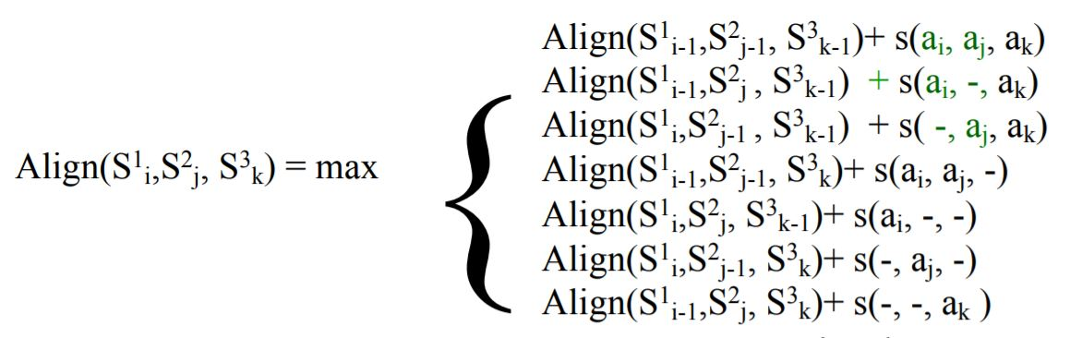

But…
And what about there are N sequences and N dimensions?
https://en.wikipedia.org/wiki/Needleman-Wunsch_algorithm
Lecture 5: Multiple sequence alignment Introduction to Computational Biology Teresa Przytycka, PhD

Slide 6
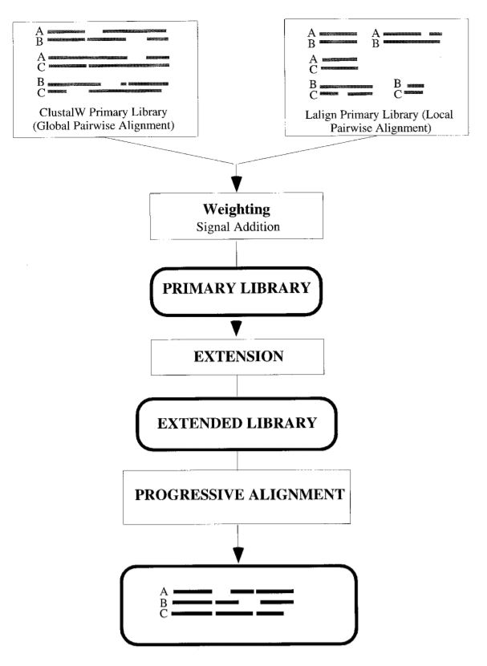
Approach 2: Progressive alignment methods*
Basic idea:
dynamic programming to obtain pair-wise alignments and build a library
evaluate the distance of each sequence in the library
progressively align the rest of the sequences in the library base on their distance/weight
similar to the process of building a phylogenetic tree
T-coffee: A Novel Method for Fast and Accurate Multiple Sequence Alignment

Slide 7
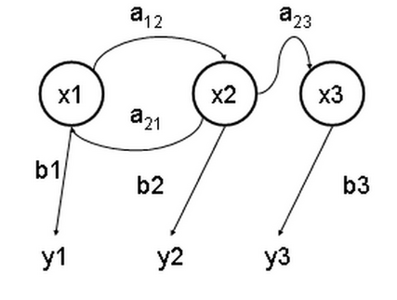
Approach 3: Iterative alignment methods*
a: transition probabilities
Basic idea:
obtain hidden pattern through database studying
using state transition function to redistribute probability matrix
x: hidden state
b: output probabilities
https://en.wikipedia.org/wiki/Hidden_Markov_model
y: observable output

Slide 8
Evaluation:
Efficiency: how the resources are consumed by the algorithms while outputting results?
Time complexity
Space complexity
Effectiveness: how can we evaluate the results?
Accuracy
Biological value

Slide 9
Time/Space Complexity*
Pre-conditions:
Average sequence length: L
Scale of data base (num of sequence): N
Huo HW, Xiao ZW. A multiple alignment approach for DNA sequences based on the maximum weighted path algorithms. Journal of Software, 2007,18(2):185−195

Slide 10
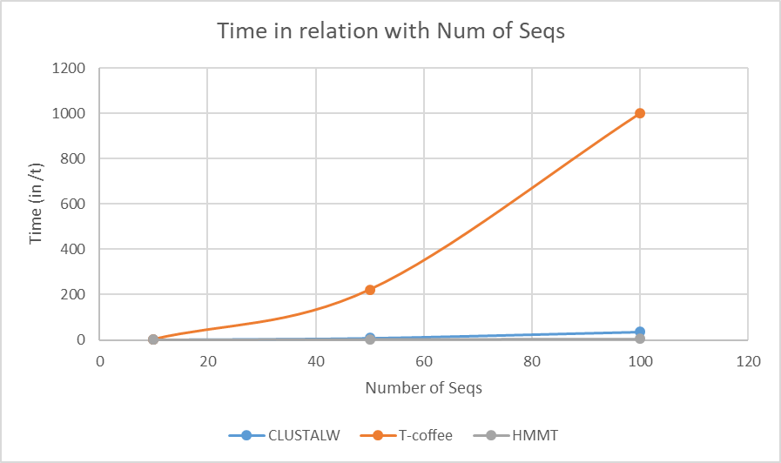
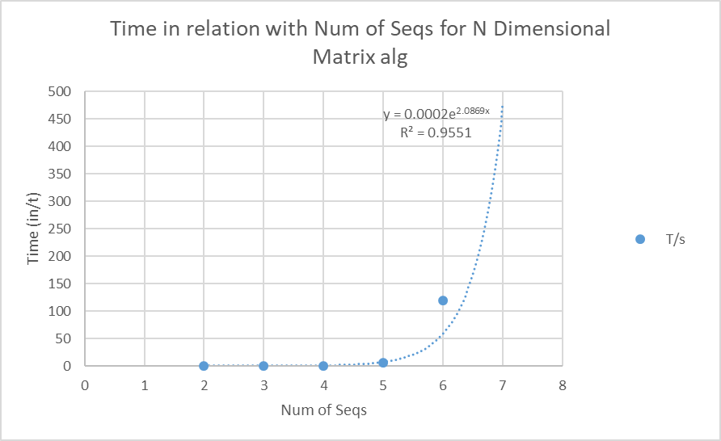
Some Data obtained:

Slide 11
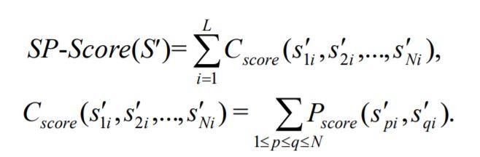

Accuracy*
Sum of pair score: the sum scores of all pairs at one position
The score of a pair of seq, denoted: P
Column score: the sum scores of one column
The score of a column of seq, denoted: c
Huo HW, Xiao ZW. A multiple alignment approach for DNA sequences based on the maximum weighted path algorithms. Journal of Software, 2007,18(2):185−195

Slide 12
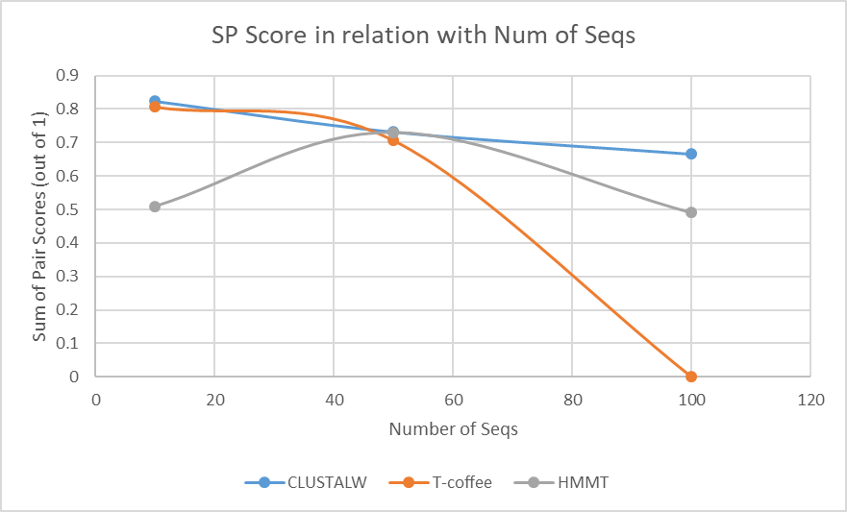
Some data obtained:

